Slide 1
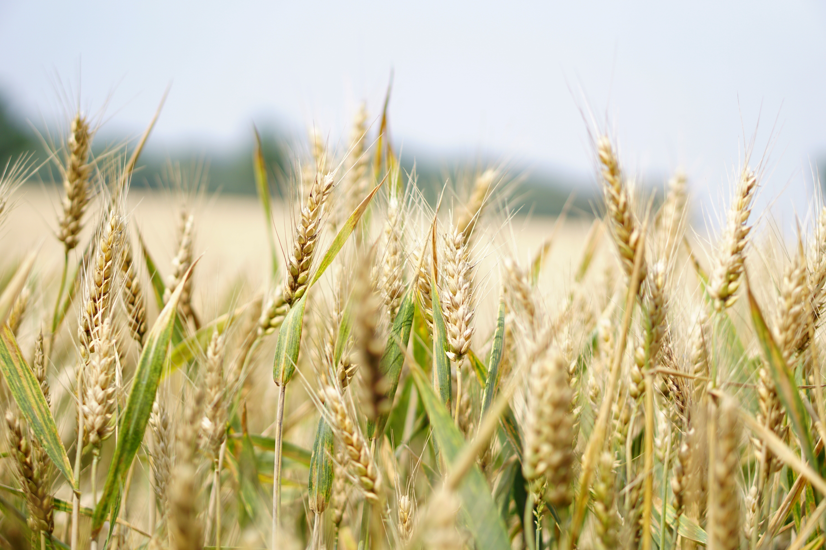
DATA VISUALIZATION on Agriculture and allied sectors in India

Slide 2
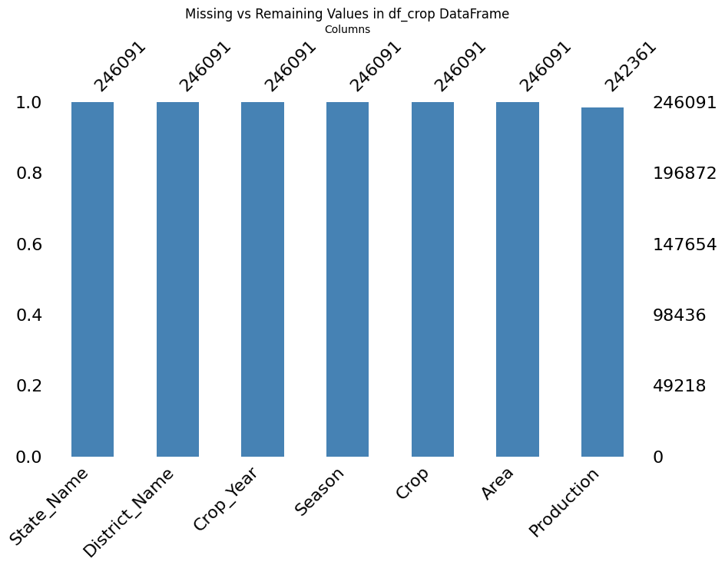
Dataset: Crop_production.csv
Columns: 'State_Name', 'District_Name', 'Crop_Year', 'Season', 'Crop', 'Area', 'Production’
Rows: 246091
Missing Values: Production has 3730 Missing values

Slide 3
Dataset: Fish_Production.csv
Columns: ['States or Union Territories', 'Marine - 2007-08', 'Inland - 2007-08',
'Total - 2007-08', 'Marine - 2008-09', 'Inland - 2008-09',
'Total - 2008-09', 'Marine - 2009-10', 'Inland - 2009-10',
'Total - 2009-10', 'Marine - 2010-11', 'Inland - 2010-11',
'Total - 2010-11', 'Marine - 2011-12', 'Inland - 2011-12',
'Total - 2011-12', 'Marine - 2012-13', 'Inland - 2012-13',
'Total - 2012-13’]
Rows: 35
The above data is in wide format and while processing converted that into long format

Slide 4
Dataset: Horticulture.csv
Columns: ['Category', 'State/ UT Name', 'Brinjal-Area-2009-10',
'Brinjal-Production-2009-10', 'Brinjal-Area-2010-11',
'Brinjal-Production-2010-11', 'Brinjal-Area-2011-12',
'Brinjal-Production-2011-12', 'Brinjal-Area-2012-13',
'Brinjal-Production-2012-13',
...
'Total-Area-2010-11', 'Total-Production-2010-11', 'Total-Area-2011-12',
'Total-Production-2011-12', 'Total-Area-2012-13',
'Total-Production-2012-13', 'Total-Area-2013-14',
'Total-Production-2013-14', 'Total-Area-2014-15 @',
'Total-Production-2014-15 @’]
Rows: 36
The above data is in wide format and while processing will be converted that into long format

Slide 5
Dataset: GDP_Sectorwise_Dataset.csv
Columns: ['Financial Year', 'Gross Domestic Product (in Rs. Cr) at 2004-05 Prices’, 'Agriculture & Allied Services (in Rs. Cr.) at 2004-05 Prices’,
'Agriculture (in Rs. Cr.) at 2004-05 Prices', 'Agri-culture & Allied Services -Share to Total GDP’,
'Agriculture - Share to Total GDP', 'Industry - Share to Total GDP’, ….,
'Agri-culture & Allied Services - % Growth Rate (YoY)’,
'Agriculture - % Growth Rate (YoY)', 'Industry - % Growth Rate (YoY)’,
'Mining and Quarrying - % Growth Rate (YoY)', 'Manufacturing - % Growth Rate (YoY)’,
'Services - % Growth Rate (YoY)', 'Year’ ]
Rows: 62

Slide 6
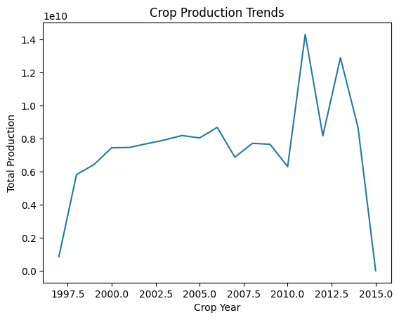
The years 2011 followed by 2013 has recorded highest Production compared to other years

Slide 7
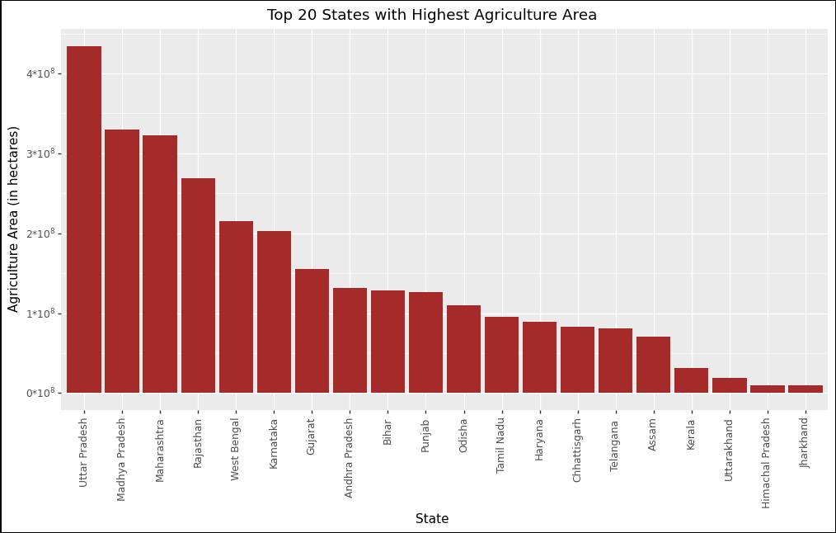

Slide 8
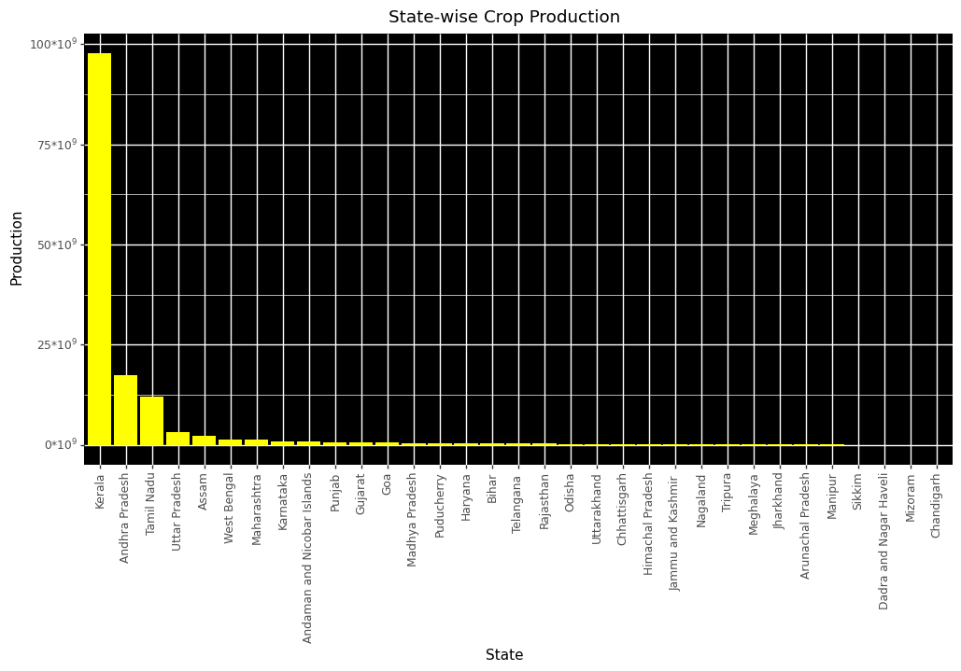

Slide 9
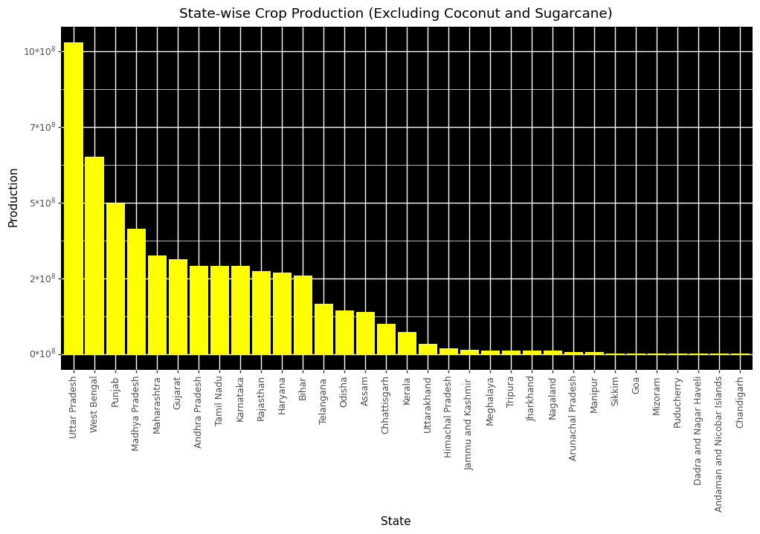

Slide 10
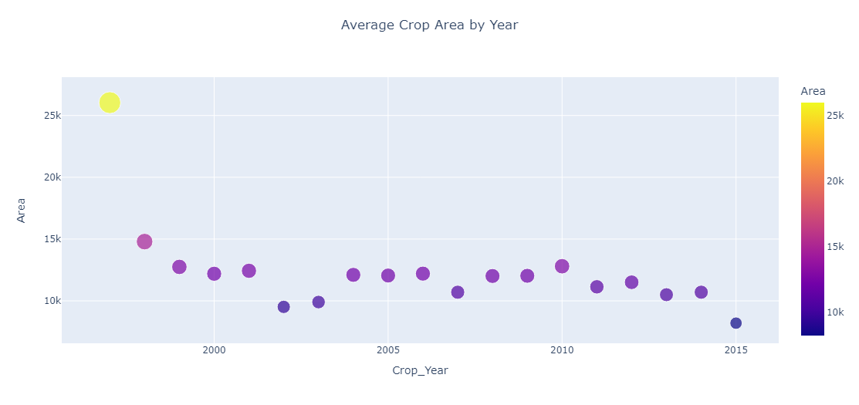

Slide 11
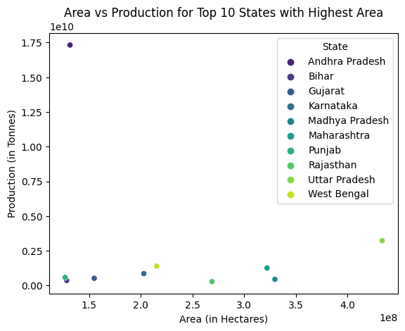
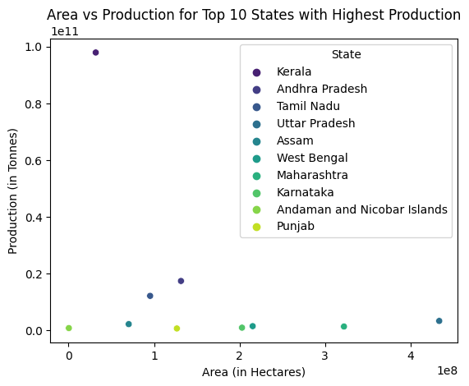

Slide 12
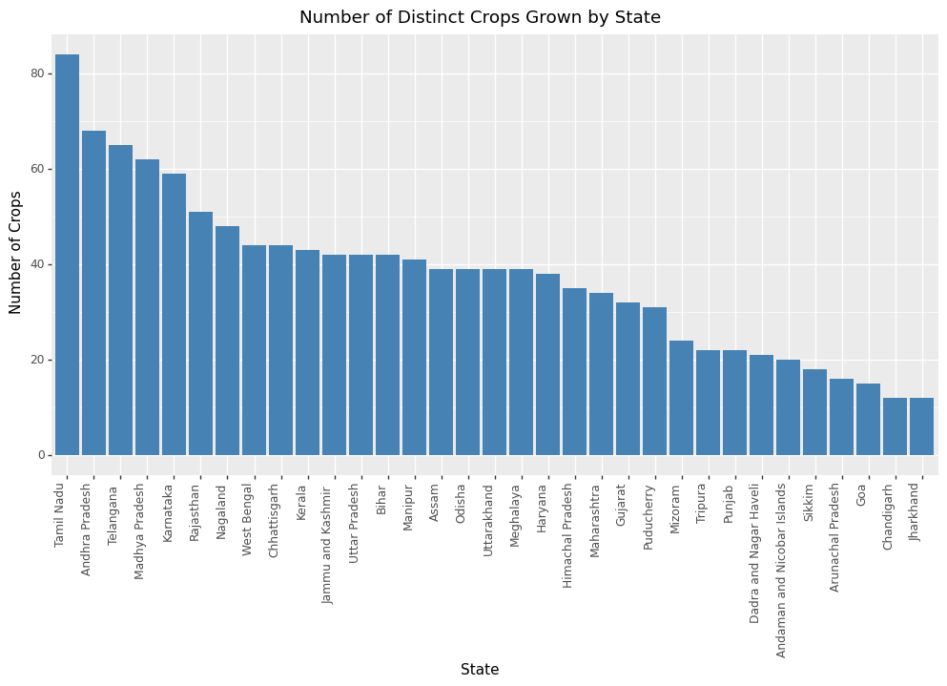

Slide 13
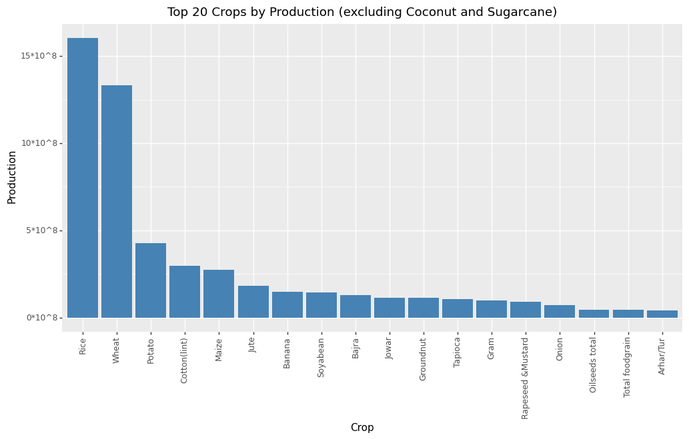

Slide 14
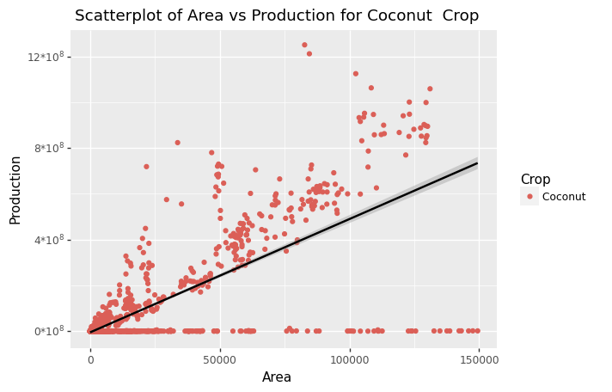
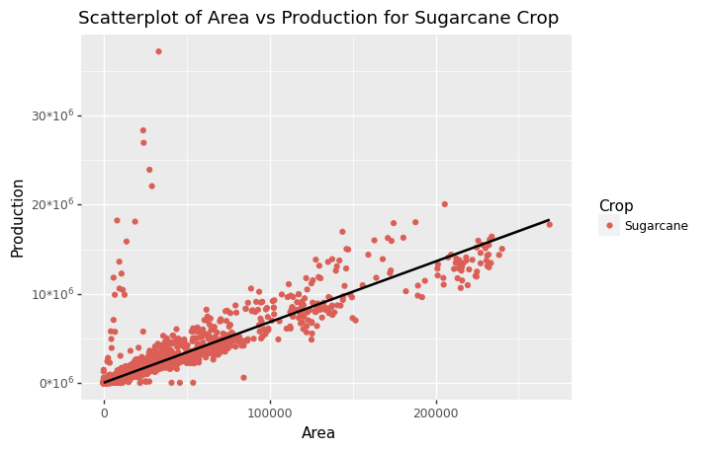

Slide 15
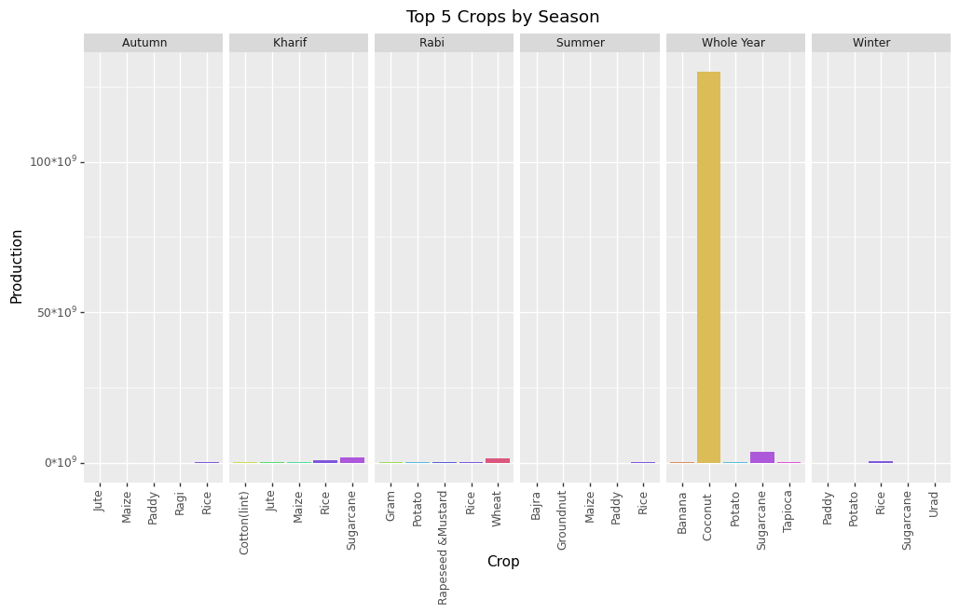

Slide 16
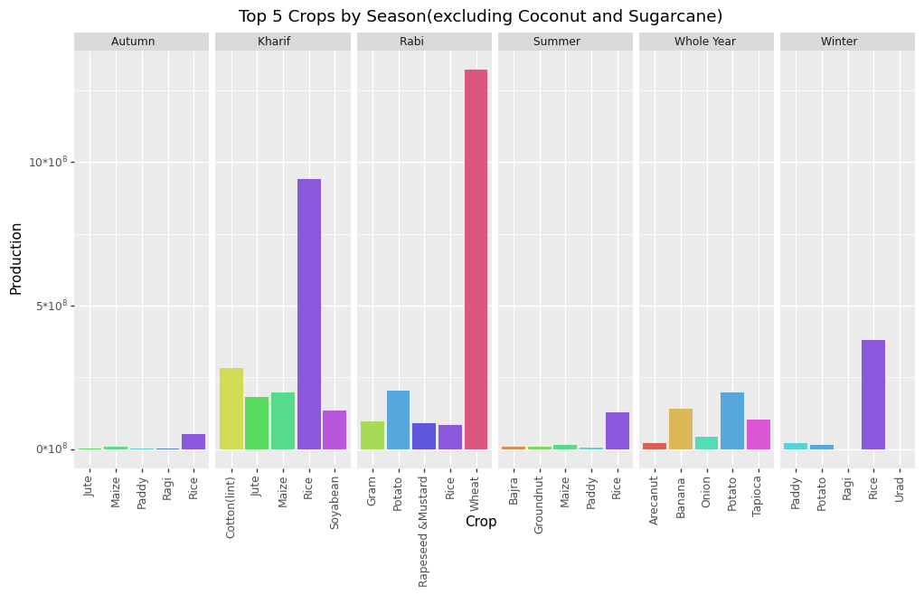

Slide 17
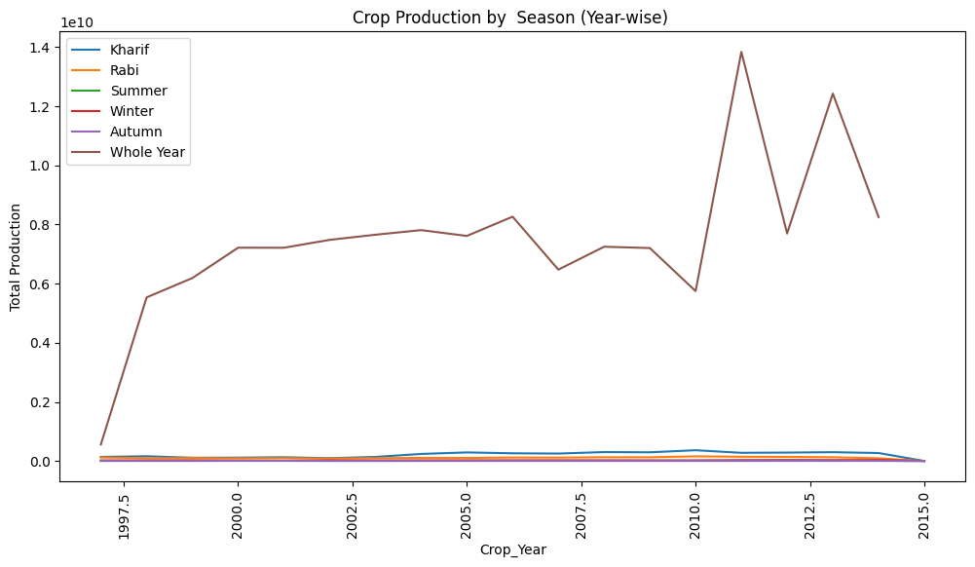

Slide 18
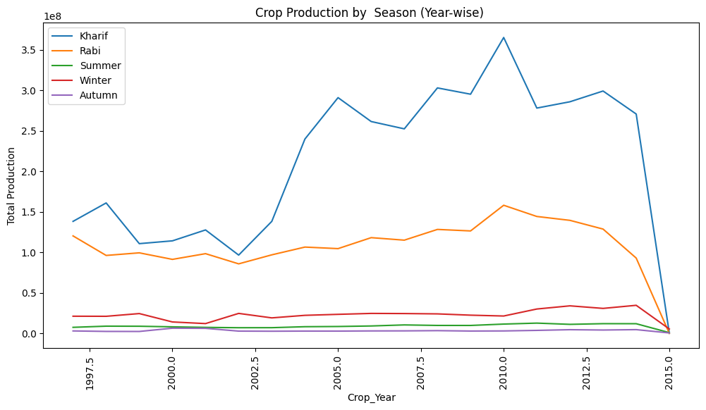

Slide 19
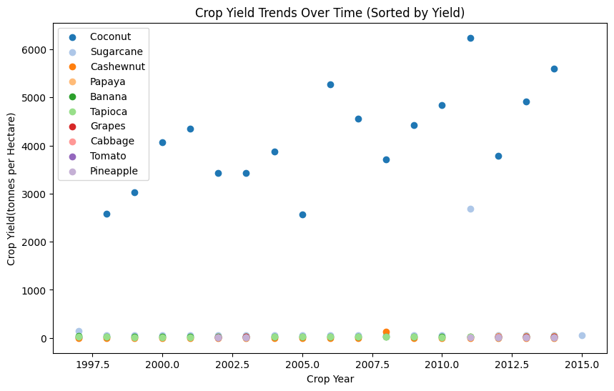
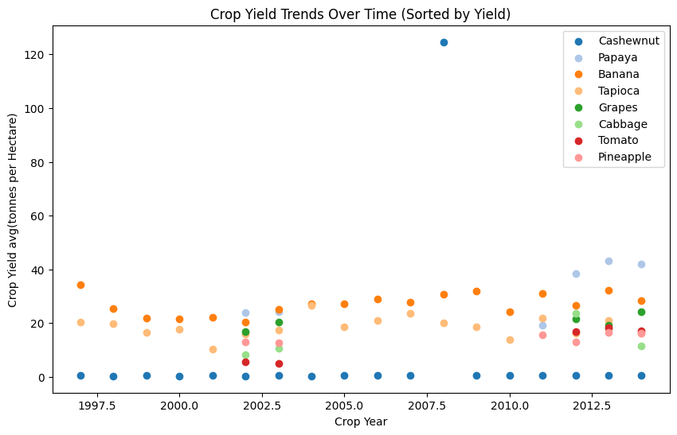
Anomaly in Sugarcane and Cashewnut Data

Slide 20
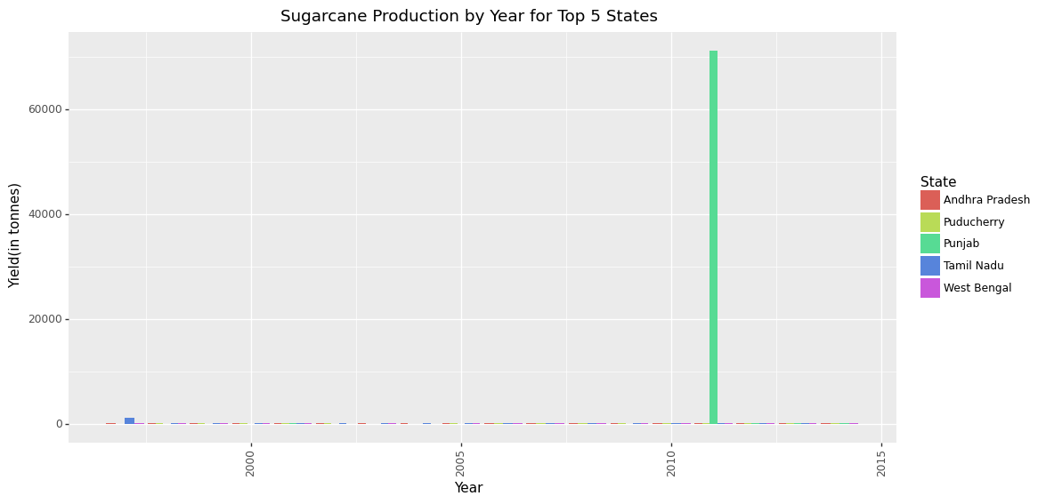

Slide 21
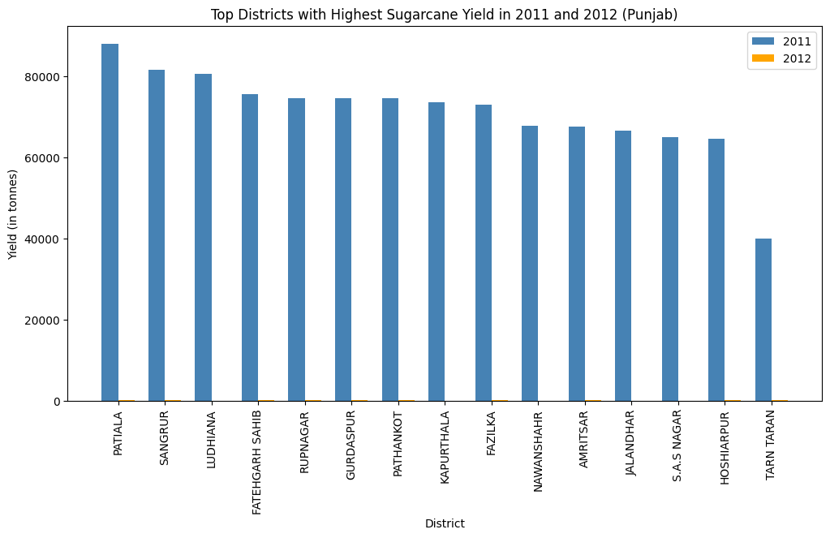

Slide 22
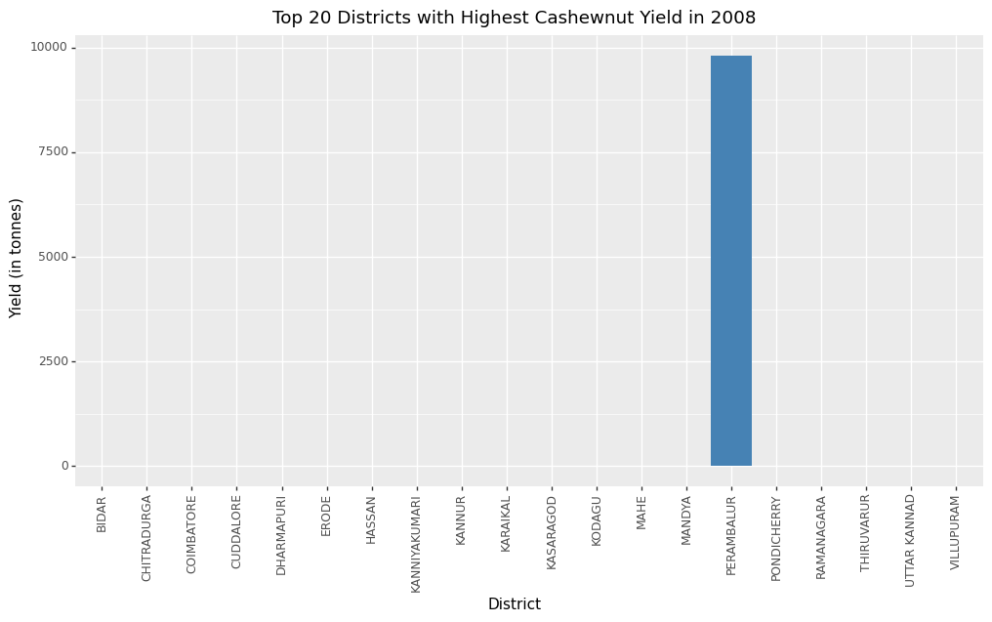

Slide 23
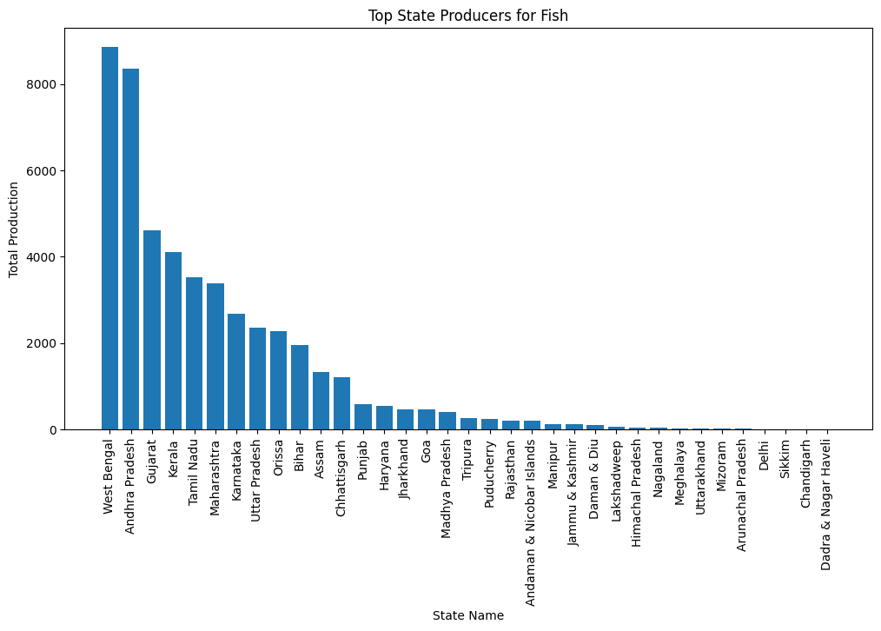
FISH Production Dataset

Slide 24
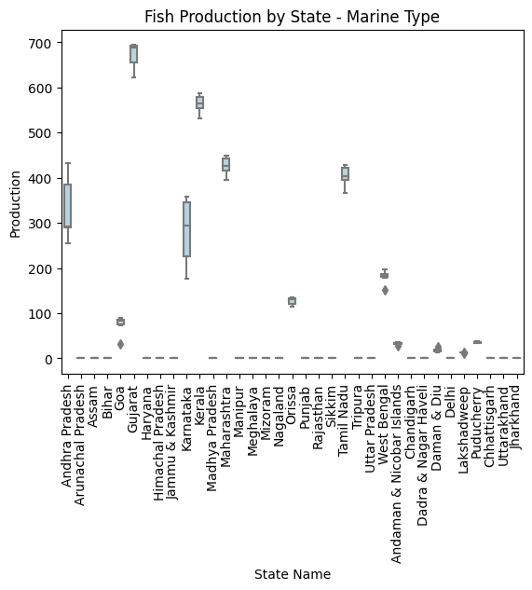
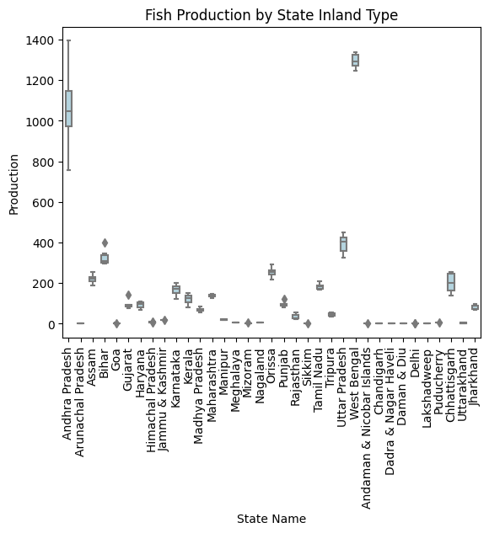

Slide 25
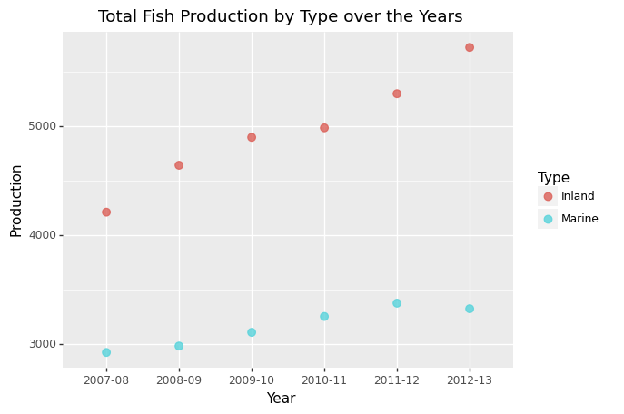

Slide 26
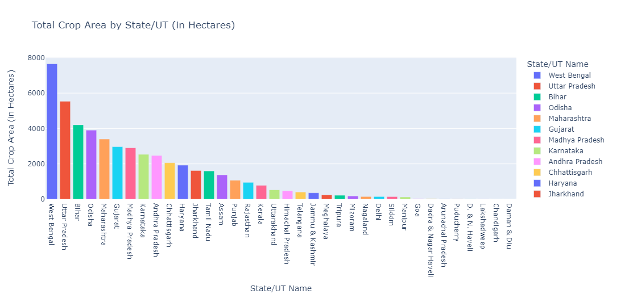
Horticulture Dataset

Slide 27
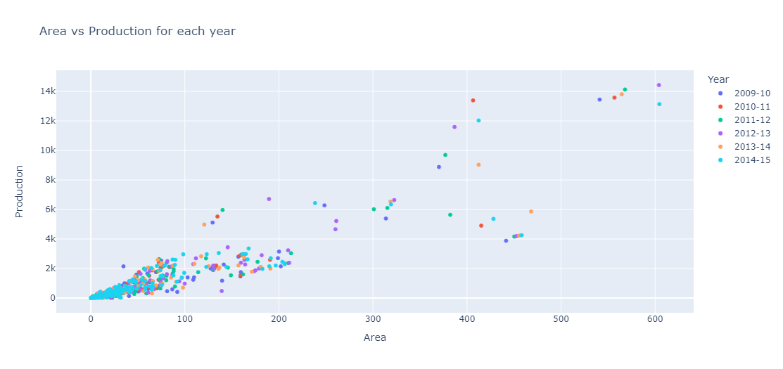

Slide 28
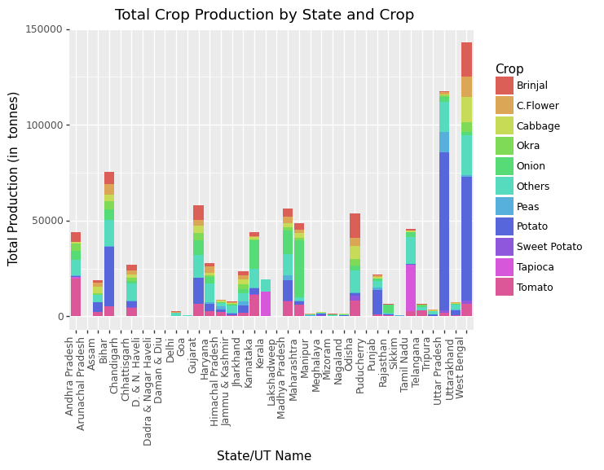

Slide 29
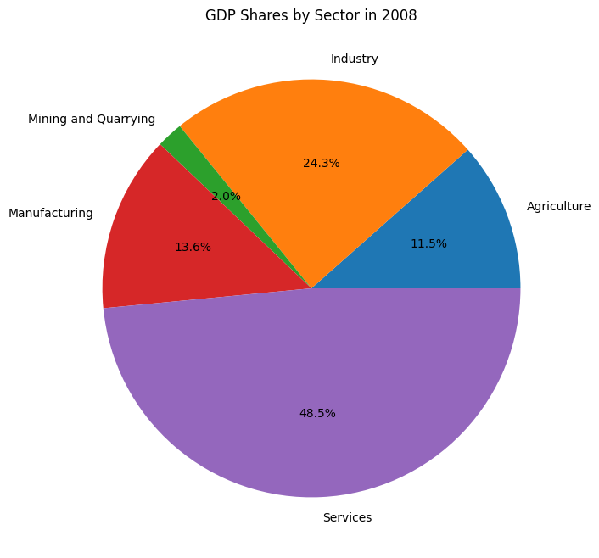
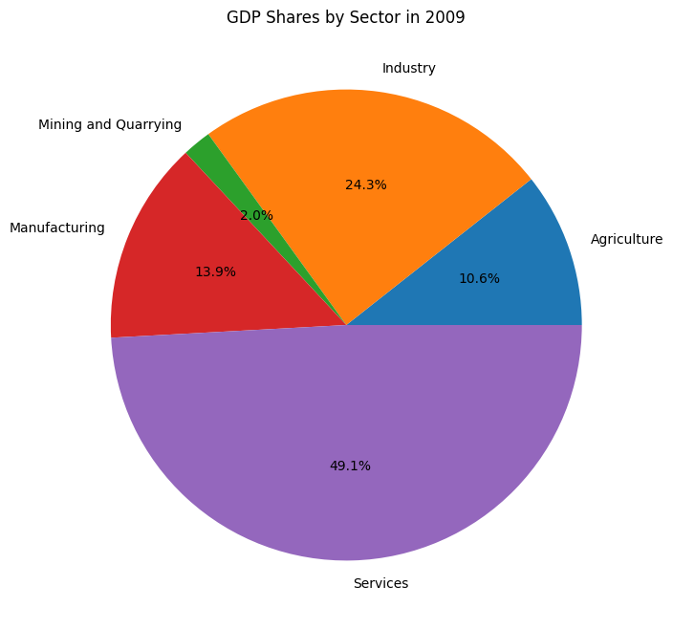

Slide 30
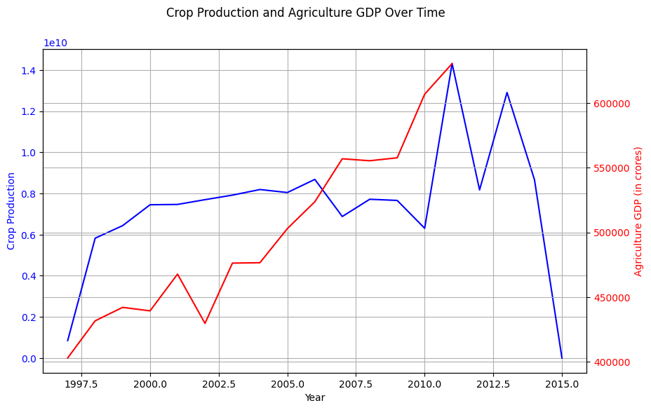
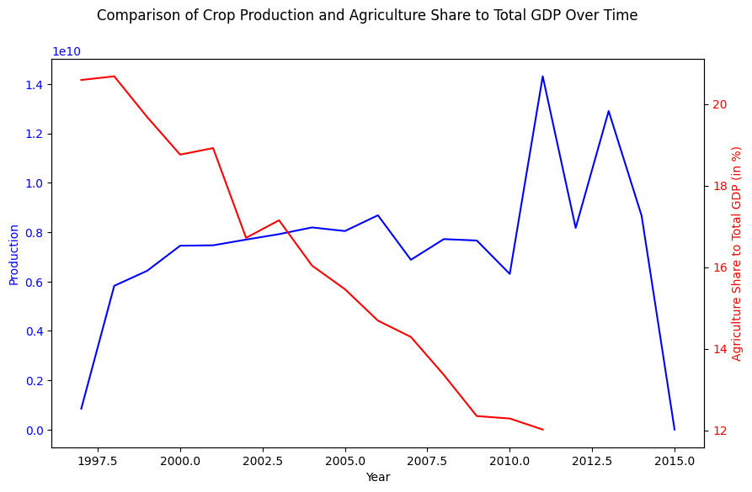

Slide 31
THANK YOU
K. AJAY KUMAR REDDY
224161017
M.tech-DATA SCIENCE

